Slide 1
HISTOLOGY OF
CARDIOVASCULAR SYSTEM
L24- Blood vessels
Prof./ Ola Abd El Tawab
Professor of Histology- Faculty of Medicine- Assiut University

Slide 2
Learning objectives (Lecture 24 / 3rd week)
After the lecture, students should be able to:
▪Mention the types of the blood vessels.
▪ Recognize the different parts of the wall of the blood vessel
▪ Discuss the normal structure of endothelial cells.
▪ List the types of arteries and veins.

Slide 3
Histology of the blood vessels
General structure of blood vessels:
Blood vessels form a continuous path for blood flow that starts and ends at the heart. Arteries carry blood away from the heart, regardless of the degree of blood oxygenation. Veins carry blood toward the heart. Between arteries and veins, there is a network of capillaries that spread inside all organs, reaching practically every cell in the body. The thin walls of capillaries allow for the passage of substances between blood and interstitial fluid, surrounding the cells bringing nutrients, gases and signaling molecules to the cells and removing waste to the blood stream. Capillaries are therefore known as the exchange vessels.

Slide 4
Walls of both arteries and veins have the same three-layered structure. Moving from the inside to outside, these layers, called tunics (singular tunica), are:
1- Tunica intima (innermost)
2- Tunica media (middle)
3- Tunica adventitia (outermost)

Slide 5
1-Tunica intima
The tunica intima is composed of a single layer of a specialized simple squamous epithelium called endothelium that lies on a basement membrane.
Under the microscope, the endothelial lining is very thin and can be identified by the nuclei of the simple squamous epithelial cells that protrude into the lumen of the blood vessel.
The tunica intima of arteries appears wavy because of the elastic fibers below it. This “wrinkling” allows for stretching without excessive stress on the endothelial cell layer.

Slide 6
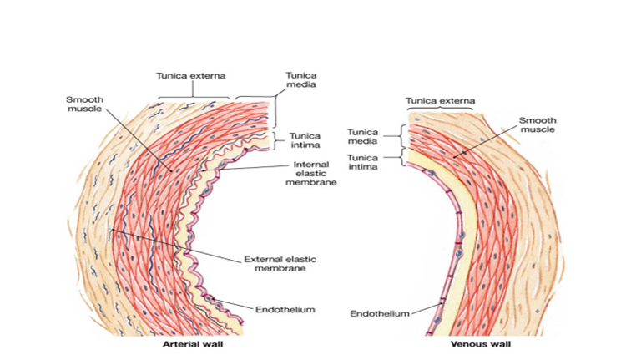
The tunica intima of a vein appears smooth as veins have no elastic fibers in their structure. In large arteries, there is also an additional layer of elastic fibers known as the internal elastic membrane. The internal elastic membrane is not present in veins.

Slide 7
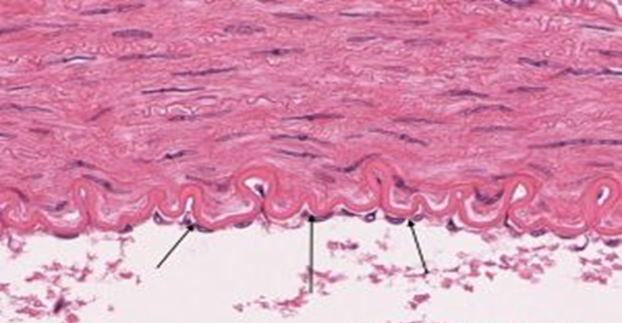
Arrows indicating the nuclei of the simple squamous epithelium

Slide 8
2- Tunica media
The tunica media is the middle layer of the vessel wall. It is a layer of smooth muscle with some elastic and collagen fibers mixed in.
Under the microscope, the tunica media is the thickest layer in arteries, and is much thicker in arteries than it is in veins. The elastic fibers within this layer appear as wavy lines between the smooth muscle cells.
In larger arteries, separating the tunica media from the tunica adventitia is the external elastic membrane.

Slide 9
3- Tunica adventitia
The tunica adventitia is a layer of connective tissue composed of ordinary C.T. containing fibroblast, Collagen and elastic fibers .The tunica adventitia is normally the thickest layer in veins .

Slide 10
Types of blood vessels:
There are 3 main types of vessels
Arteries (A) : carry blood from heart to the body (elastic and muscular arteries)
Arterioles: deliver blood to capillaries
A-V junctions.
Venules: drain blood from the capillaries.
Veins (V): collecting vessels that bring blood back to the heart.
Generally, arteries have a thick wall with a narrow lumen, while veins have thin wall and a wide lumen.

Slide 11
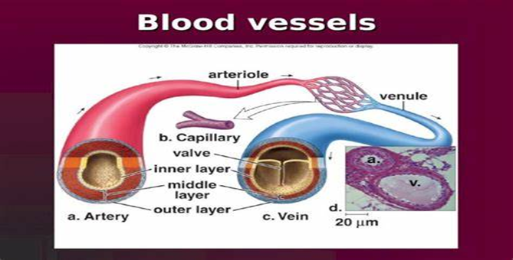

Slide 12
Arteries
An artery is a blood vessel that conducts blood away from the heart. All arteries have relatively thick walls that can withstand the high pressure of blood ejected from the heart.
Based on their distance from the heart, arteries can be divided into three types:
• Large Elastic arteries.
• Muscular arteries.
• Arterioles.

Slide 13
Large Elastic Arteries (Aorta)
Elastic arteries or conducting arteries, comprise large arteries that leave the heart. The aorta and the major first branches from the heart, such as the brachiocephalic artery, common carotid, and subclavian belong to this category.
Histological Features:
Tunica intima:
It is composed of an endothelium supported by a narrow sub endothelial layer of
C.T. The internal elastic lamina is present but indistinct.
2- Tunica media: (the thickest layer):
It consists of many fenestrated lamellae of elastin alternating with circularly
oriented layers of smooth muscle cells. Smooth muscle cells are less abundant
in elastic arteries.
Tunica Adventitia :It is thin layer of loose fibroelastic C.T. containing vasa vasorum.

Slide 14
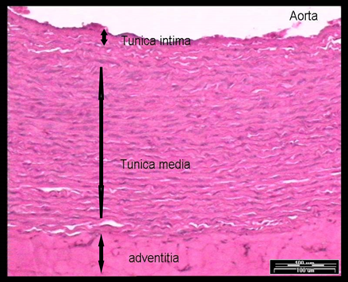

Slide 15
Large Veins
These vessels have a diameter larger than 10 mm, such as the venae cava, pulmonary vein, renal, adrenal, splenic and superior mesenteric veins.
Histological Features:
Their walls have three layers: -
The tunica intima consists of an endothelial lining with basal lamina, a small amount of sub endothelial connective tissue and smooth muscle cells, which are close to the intimal endothelium.
The tunica media : is the thin layer which contains few smooth muscle cells, collagen fibers and some fibroblasts. No internal or external elastic Lamina.

Slide 16
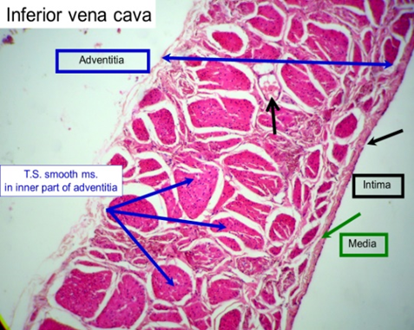
The tunica adventitia : is the thickest layer of the vessel wall, which consists of collagen, elastic fibers, fibroblasts and vasa vasorum.
NB. The inferior vena cava has longitudinally arranged bundles of smooth muscle fibers. Contraction of these muscle fibers helps in propelling blood towards the heart against gravity.

Slide 17
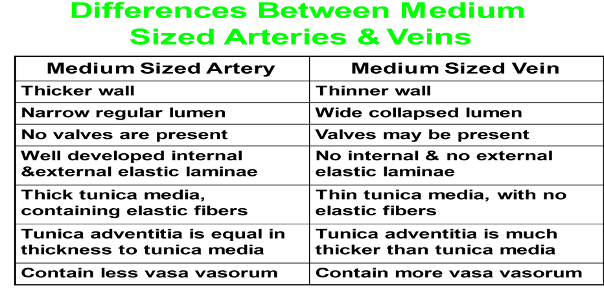

Slide 18
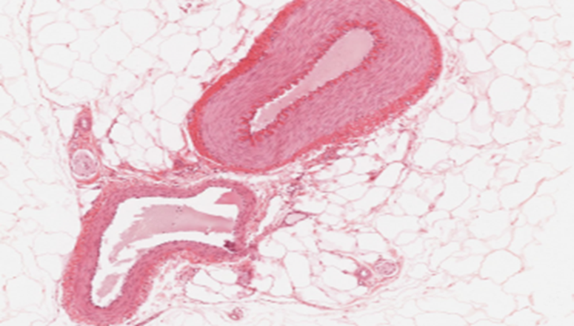

Slide 19
Vasa vasorum
The walls of arteries and veins are composed of living cells that require nourishment and produce waste. Since blood passes through the larger vessels relatively quickly, there is limited opportunity for blood in the lumen of the vessel to provide nourishment to or remove waste from the blood vessel’s walls. Further, the walls of larger vessels are too thick for nutrients to diffuse through to all of the cells. Larger arteries and veins contain small blood vessels in the tunica adventitia known as the vasa vasorum to provide them with this vital exchange.

Slide 20
Endothelial cell
It is important to remember that the entire cardiovascular system is lined by endothelial cell. This specialized simple squamous epithelial cell lines the endocardium of the heart, lines all the arteries and veins, and makes up all the capillaries wall.
❖ The endothelial cells rest on a basal lamina. These flattened polygonal cells are elongated in the direction of blood flow. The nucleus causes the cell to bulge into the capillary lumen. The cytoplasm contains few organelles including a small Golgi complex, mitochondria, free ribosomes & a few cisternae of RER. Endothelial cells are connected to each other by tight junctions.

Slide 21
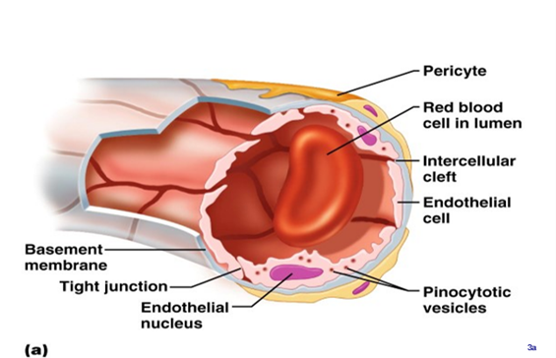

Slide 22
Functions of endothelial cells:
1- They provide smooth surface.
2- They secrete collagen, lamin, endothelin and nitric oxide.
3- They have membrane bound enzymes for bradykinin, serotonin, prostaglandins, thrombin, norepinephrine and lipoprotein lipase.

Slide 23
Lecture 25
(Blood capillaries, specialized arteries)
and
(Sensory structures of blood vessels)

Slide 24
Learning objectives (Lecture 25 / 3rd week)
After the lecture, students should be able to:
- Describe the general structure of blood capillaries.
- Mention different types of blood capillaries .
- Recognize the different types of special arteries..
- Discuss the normal sensory structure of blood vessels (carotid
sinuses & carotid and aortic bodies).

Slide 25
Blood Capillaries
Capillaries are the smallest blood vessels which form branching and anastomosing network between arterioles and venules. Their diameter is 8-10 um slightly larger than the diameter of RBCs.
General Structure of blood Capillaries:
The blood capillaries are lined by a single layer of flat endothelial cells rolled up in the form of a tube rest on basal lamina. The basal lamina split to enclose pericytes. Pericytes are flat branched contractile cells.
Large number of pinocytotic vesicles are present on both surfaces of endothelial cells. These vesicles are responsible for transport of macromolecules in both directions across the endothelial cytoplasm. This process is called transcytosis.

Slide 26
At the cellular junctions, the endothelial cells tend to overlap forming marginal folds that project into the lumen. These folds may retard the flow of blood near the capillary wall. The endothelial cells are connected by tight junctions to prevent the leakage of proteins or blood cells out of circulation.

Slide 27
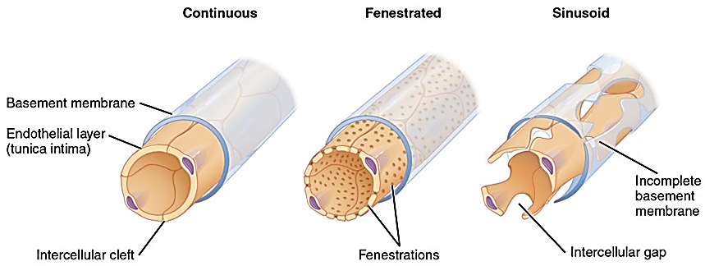
Types of blood Capillaries

Slide 28
Structurally by E.M. there are three types of capillaries
1- Continuous capillaries
2- Fenestrated capillaries
3- Sinusoidal capillaries(blood sinusoids)
Continuous capillaries : are the most common type, and are found in muscle, the central nervous system, and the lungs. They are characterized by uninterrupted endothelial and continuous basal lamina. Cells are tightly sealed and permeable only to fluid and the smallest of molecules, such as ions.
In the brain, the blood capillaries are modified continuous capillaries that form the blood brain barrier, with very low permeability. Few or no pinocytotic vesicles are encountered in these continuous capillaries. • Occluding junction between endothelial cells represent the main structural component of the barrier.

Slide 29
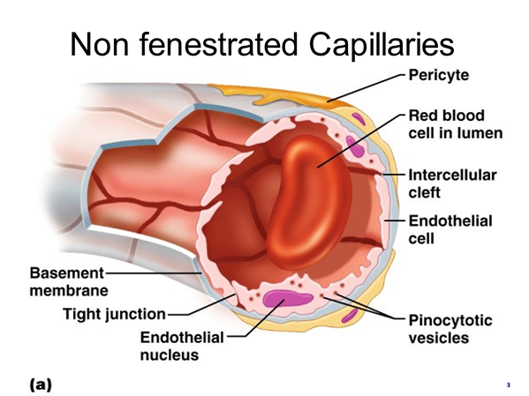

Slide 30
Fenestrated capillaries : The endothelial cells have pores (60 -80 nm in diameter), and usually covered by a pore diaphragm. The basal lamina is continuous. They are present in endocrine glands, intestines, and the kidney glomeruli, where their structure allows for the transport of larger molecules such as hormones or fat particles.

Slide 31
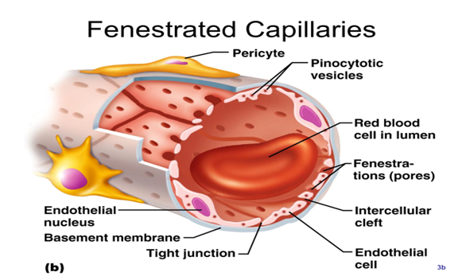

Slide 32
Sinusoidal capillaries, or sinusoids, can be found in the liver, spleen, and bone marrow. The endothelial wall and the basal lamina are discontinuous. The fenestrae in the endothelial cells are without diaphragm. Macrophages may be located either in or along the outside of the endothelial wall. They have large gaps between cells that allow larger particles, and even blood cells, to enter or exit the blood.
Capillaries are exchange vessels, as the interchange of nutrients/waste between blood and organs takes place across their walls.

Slide 33
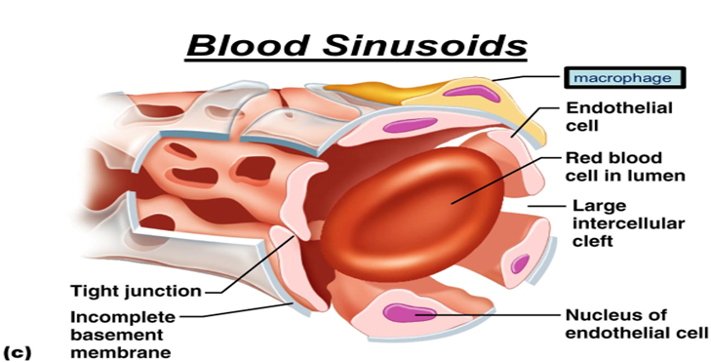

Slide 34
Specialized Medium Sized Arteries
    1.Cerebral (basilar) Arteries:
They have thin wall because they are protected from external forces by skull.
The tunica media is thin and devoid of elastic fibers.
The internal elastic lamina is well developed.
    2.Pulmonary Arteries
These vessels are thin walled, because they are exposed to low pulmonary blood pressure. They contain less muscular and elastic tissue.
    3.Coronary Arteries
They have a very thick wall because they are subjected to high pressure. The intima is thickened. The sub endothelium contains longitudinal smooth muscle fibers, elastic fibers, amorphous intercellular substance, fat droplets and monocytes. They have thicker media to withstand internal pressure and external forces.

Slide 35
    4. Umbilical Arteries:
The tunica intima lacks internal elastic lamina.
The tunica media is chiefly muscular.
The muscle layer of the media is divided into 2 layers: an inner longitudinal and outer circular layer. This arrangement will enable the umbilical artery to undergo complete occlusion after birth.

Slide 36
Specialized Sensory Structures in Arteries
They are located in the major arteries of the body; they include carotid sinuses, carotid and aortic bodies. Function: Nerve endings in these structures monitor blood pressure and blood composition, by sending impulses to the brain for controlling heart rate, respiratory rate and blood pressure.
1- Carotid sinus:
❖ Site: It is a dilatation of the wall of the internal carotid artery just above the
bifurcation of the common carotid artery.
❖ Histological structure: At the site of the carotid sinus, the adventitia of the
internal carotid artery is relatively thicker and heavily supplied with sensory
nerve ending from the glossopharyngeal nerve (IX). The media is thinner, so, it
distends during increase in blood pressure.
❖ Function: It is a baroreceptor when stimulated by an increase of arterial blood pressure: it sends inhibitory impulses to respiratory and cardiovascular centers.

Slide 37
2- Carotid Body:
❖Site: It is located at the bifurcation of the common carotid artery.
❖ Histological structure: It is composed of multiple clusters of pale- staining
cells embedded in C.T. Glomus cells :( chemoreceptor cells) and Sheath cells: (supporting cells)
Function: It has specialized chemoreceptor nerve endings responsible for
monitoring changes in O2 &CO2.
3- Aortic Body:
Site: they are located on the aortic arch between the common carotids and the subclavian arteries.
Structure & function are similar to those of the carotid body.

